Slide 1
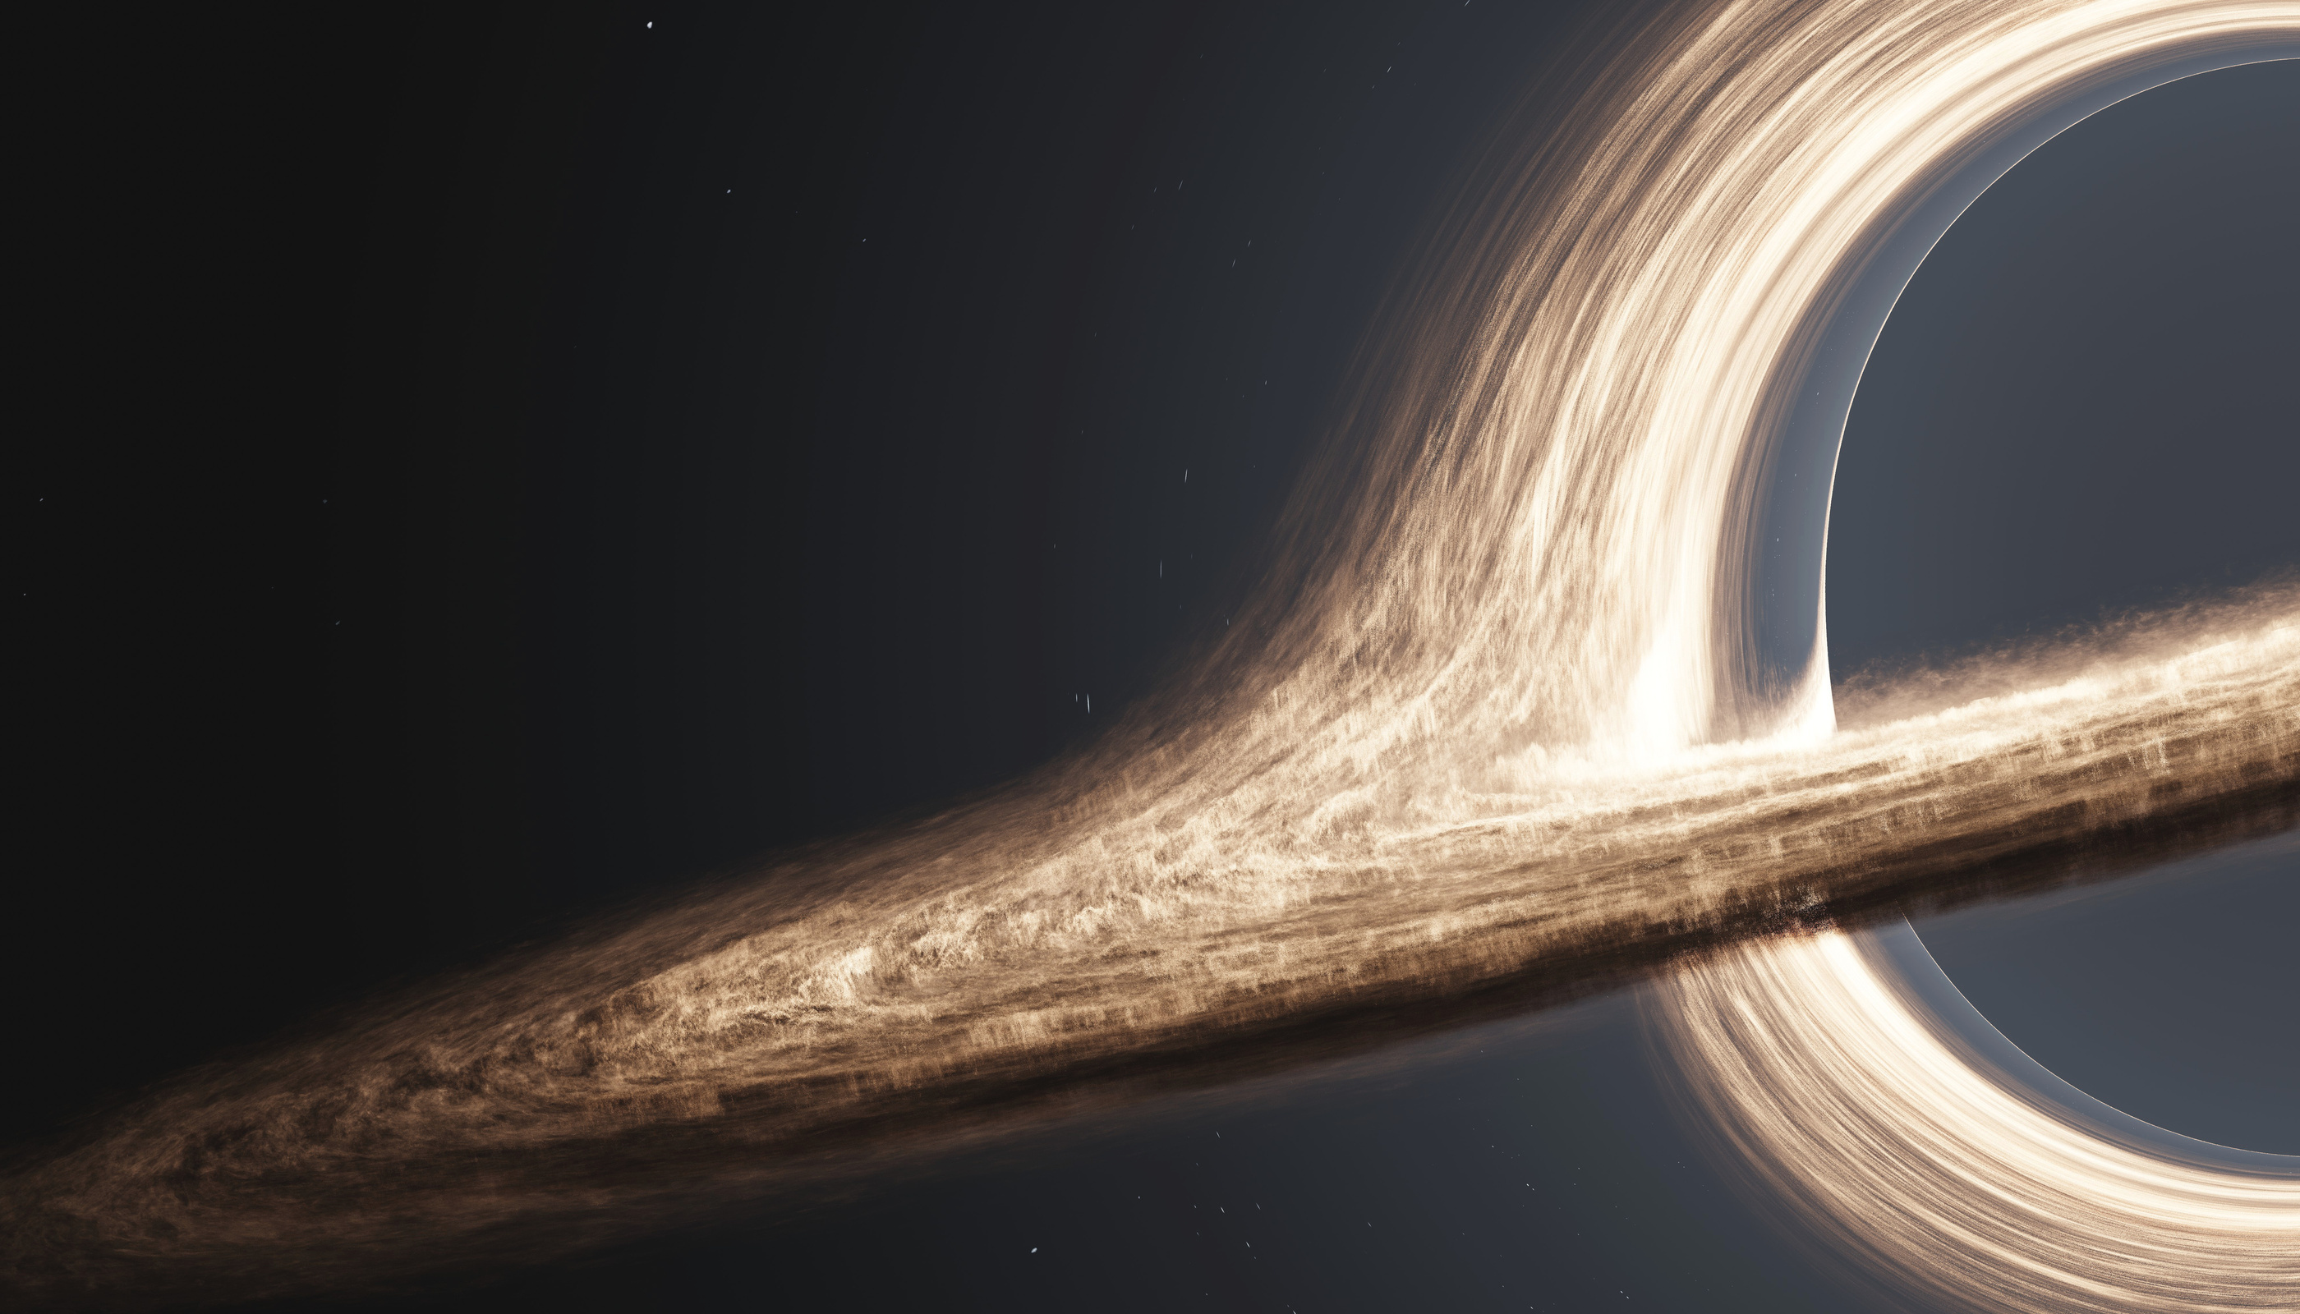

WOMEN IN DATA DATATHON
2025
TEAM DATANOVA
1

Slide 2

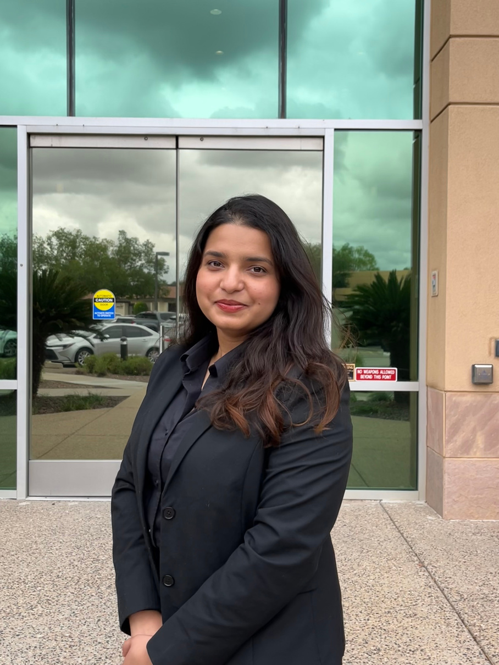

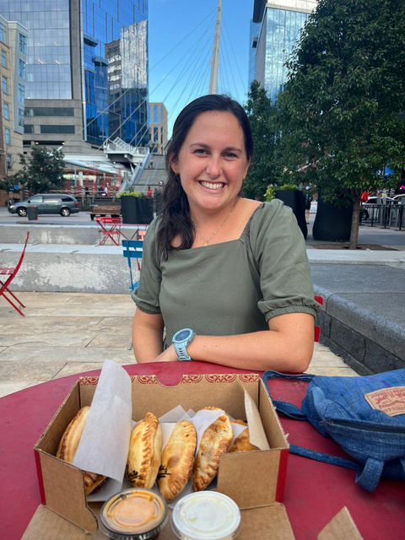
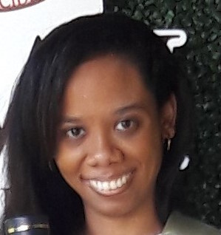
MEET OUR TEAM
Kamayani Rai
Kundana Rasi Tadikonda
Julia Davis
Kimberley Gillette
Applied Analytics and Machine Learning
Industrial Engineering and Data Visualization
Data Science and Machine Learning
Analytics Engineering and Data Visualization
2

Slide 3

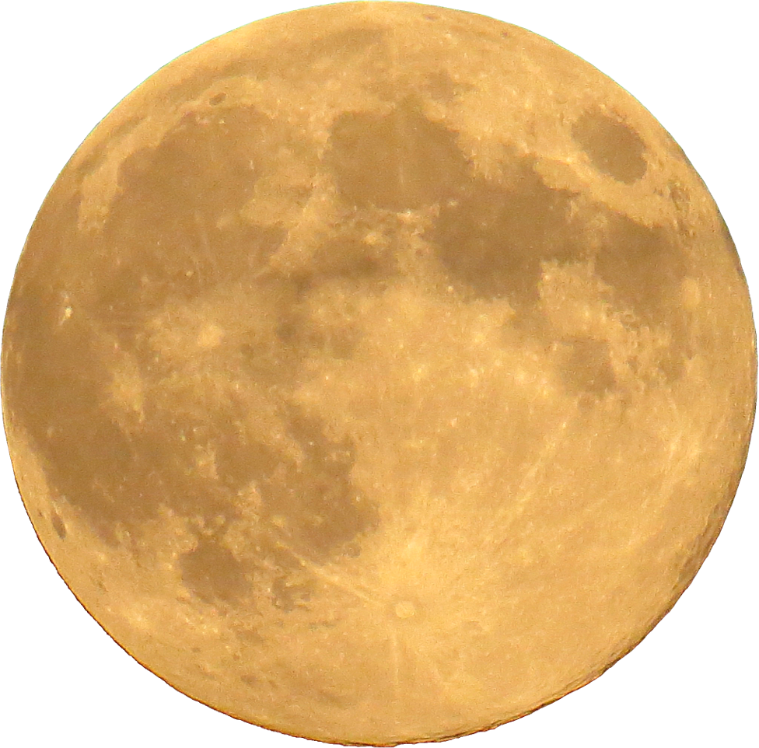
PROBLEM STATEMENT - ENHANCING SPACE SITUATIONAL AWARENESS USING OPEN DATA
01
02
03
Escalating Risk
Ineffective Mitigation
Strategic Gap
Increasing debris density in Low Earth Orbit (LEO)
Critical threats to satellites, missions, and future exploration
Active debris removal remain reactive, experimental and lack scalability
No integrated, predictive system exists to prioritize collision risks
Decision-making is slowed by fragmented data and uncertainty in forecasts
3

Slide 4

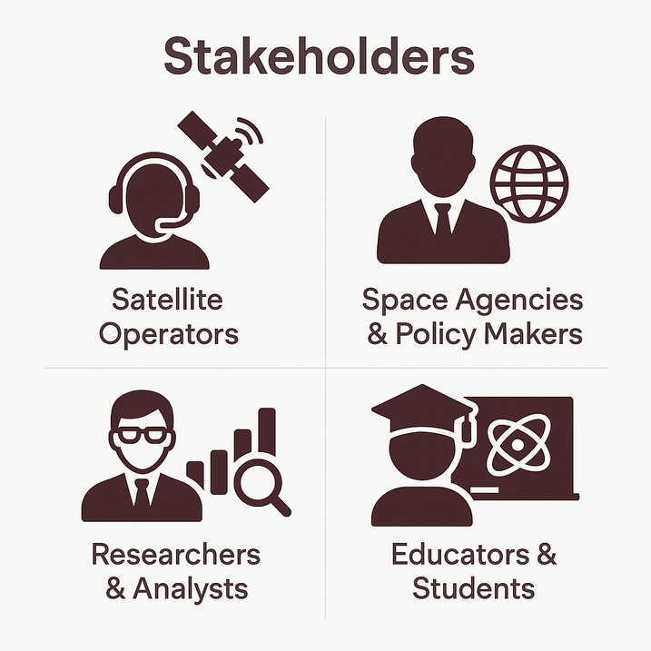
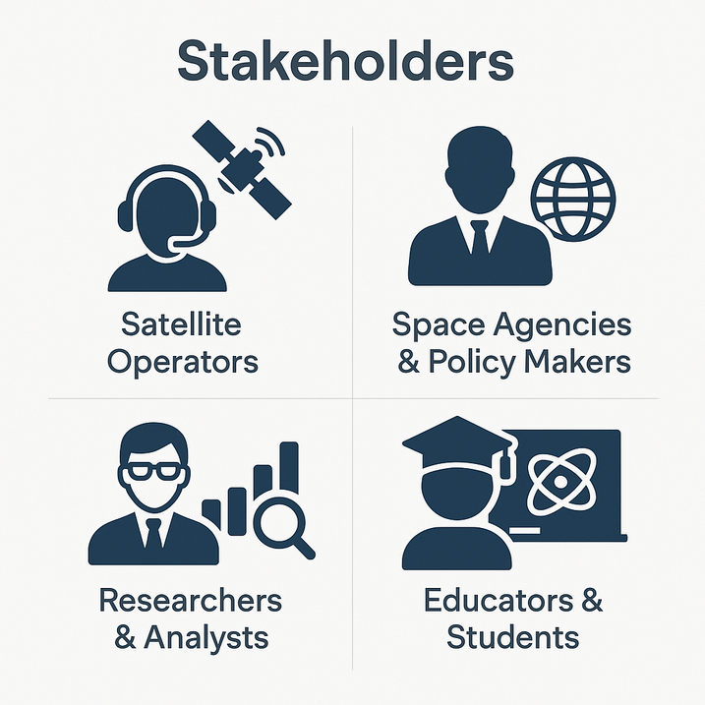

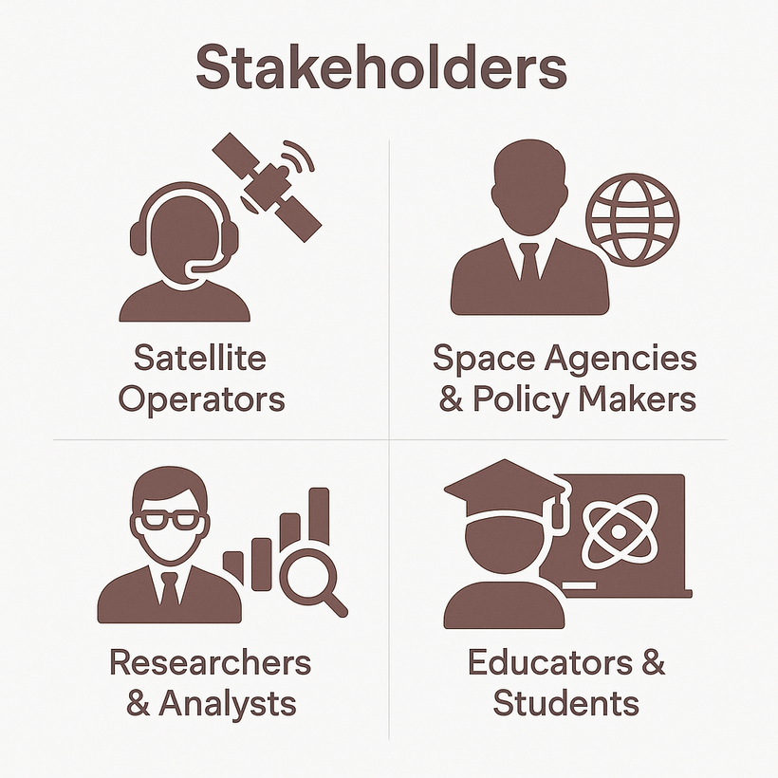
ABOUT STAKEHOLDERS
Access structured data for advanced analysis.
Get real-time alerts to prevent costly collisions.
Use insights to guide safer space policies.
Teach space safety with real-world examples.
4

Slide 5

PROPOSED SOLUTION - ORBITSHIELD
Cost Efficient, AI Driven Space Debris Management
Automated ingestion of orbital datasets
Geospatial clustering of debris (DBSCAN)
Collision probability forecasting (RF/XGBoost/LSTM)
Priority scoring by velocity, mass, mission criticality
Human-readable alerts via LLMs
Interactive dashboard: clusters, alerts, trends
Key Features
5

Slide 6

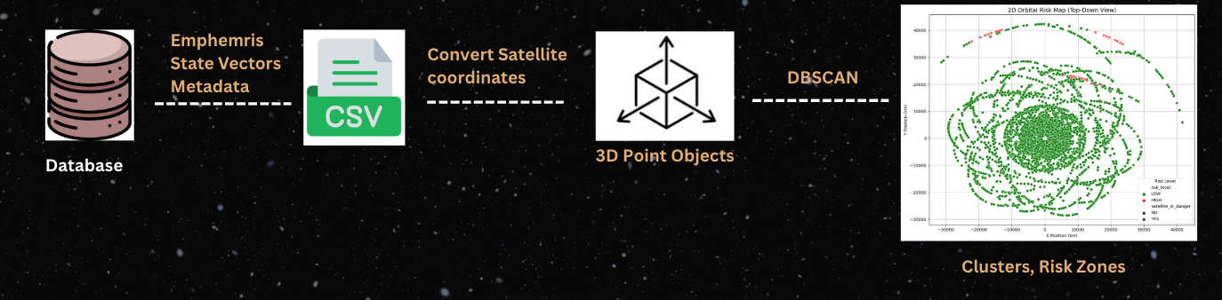
METHODOLOGY AND APPROACH
DATA EXTRACTION & FUSION
Pulled orbital datasets via UDL REST APIs (Ephemeris, State Vectors and object Metadata).
Standardized schema (object_id, epoch, x,y,z,vx,vy,vz) across sources.
Consolidated into a single dataset (~845K records, 228 objects).
GEOSPATIAL ANALYSIS
Converted orbital positions into 3D coordinates (ECI).
Applied DBSCAN clustering to identify debris-dense regions.
Identified 6 orbital clusters.
Flagged satellites passing through clusters and assigned LOW (4955) and HIGH (45) risk categories.
6

Slide 7
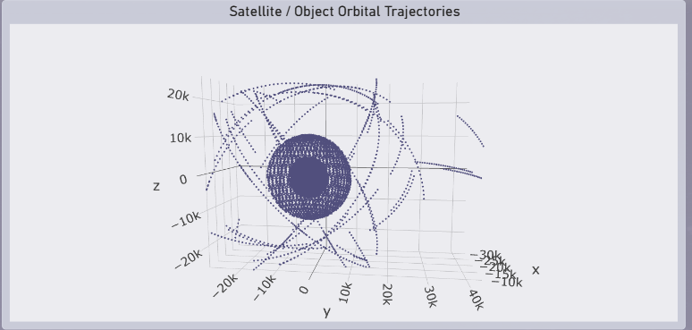
METHODOLOGY AND APPROACH
MACHINE LEARNING MODELING
Engineered features: altitude bands, relative velocity, and cluster density.
Trained Random Forest, XGBoost, and LSTM on the consolidated dataset.
Generated collision probabilities and trajectory forecast
VISUALIZATION
Orbital Dataset Overview & Trends – trajectories, counts, velocity patterns.
Collision Risk Monitoring Panel – LOW vs HIGH risks, predicted vs actual.
Debris Clusters & Satellite Risk – 3D cluster maps, danger vs safe objects.
Predictive Modeling & Forecasting – LSTM-based orbital path projections.
7

Slide 8

CHALLENGES ENCOUNTERED
No link between the Elset dataset and our consolidated dataset
Lacking object identification numbers for unknown object sightings
Setting up alerts on Slack
8

Slide 9

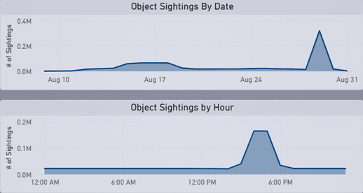
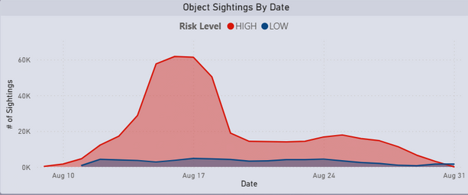
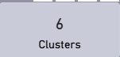
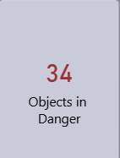
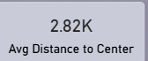
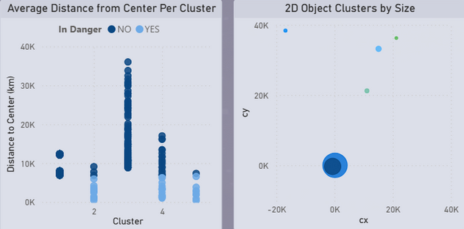
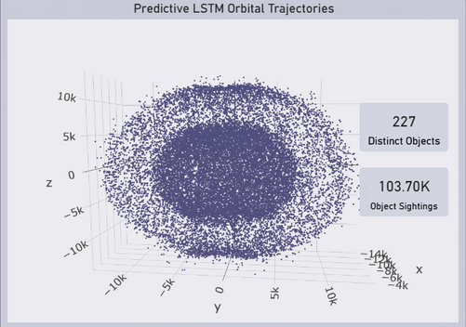
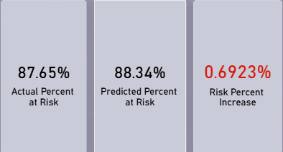
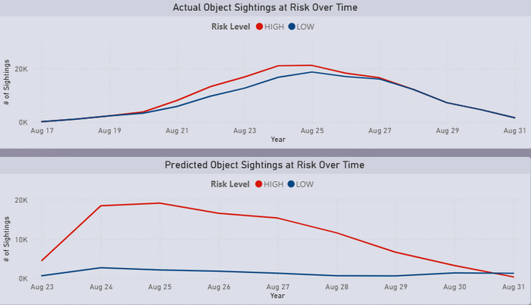
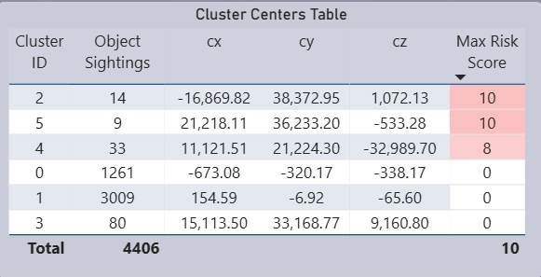
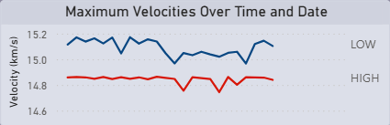
KEY FINDINGS AND INSIGHTS
Clustering & Collision Risk
Temporal Patterns & Predictions
Risk & Velocity
Risk Trend
Risk Trend Shifts
9

Slide 10
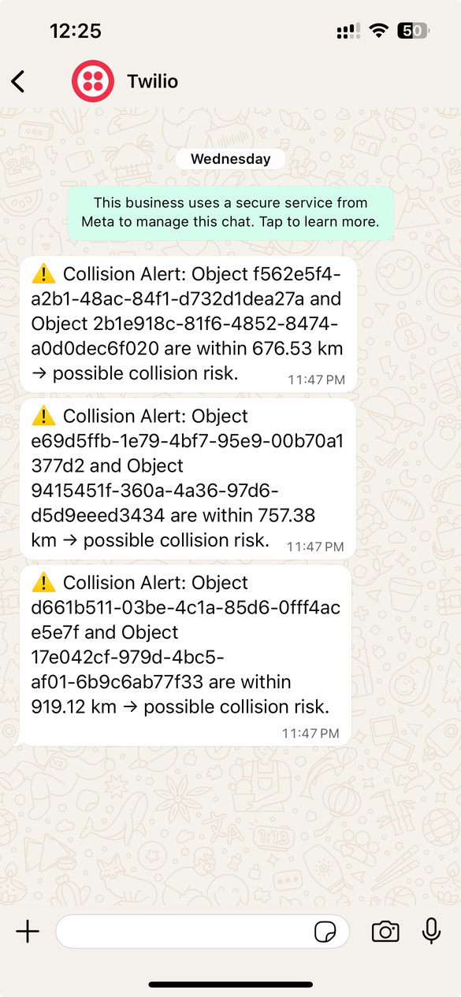
KEY FINDINGS AND INSIGHTS
Automated Satellite Risk Warnings
10

Slide 11
SOLUTION HIGHLIGHTS - ORBITSHIELD
OrbitShield turns orbital data into simple, actionable intelligence, making space safety transparent, scalable, and accessible to everyone, from satellite operators to policy makers.
Uniqueness
Combines geospatial clustering, ML forecasting, and explainable alerts.
Translates orbital risk into human-readable recommendations.
Scalability & Future Impact
Ready for real-time orbital feeds and mega-constellations
Flexible framework for global adoption
Accessibility
Simplifies orbital mechanics into dashboards + plain-language alerts
Accessible to operators, policy makers, educators, and students through open-source data
Ethical Contribution
Provides transparent, explainable models (see why risk is high)
Advances responsible space sustainability beyond technical teams
11

Slide 12

RECOMMENDATIONS AND NEXT STEPS
01
Use the dashboard to view objects’ positions, how many times an object was seen at a certain time and how fast each of these objects were moving.
02
Use the alerts provided to determine which objects are in danger of colliding and adjust the objects’ trajectory accordingly.
03
Perform machine learning modelling to predict the speed of the objects to help determine which ones will move slowly or quickly to aid with object coordination.
04
Use Elset datasets to perform further analysis to determine which satellites are decaying or likely to become debris soon to aid astronauts with debris management.
12

Slide 13

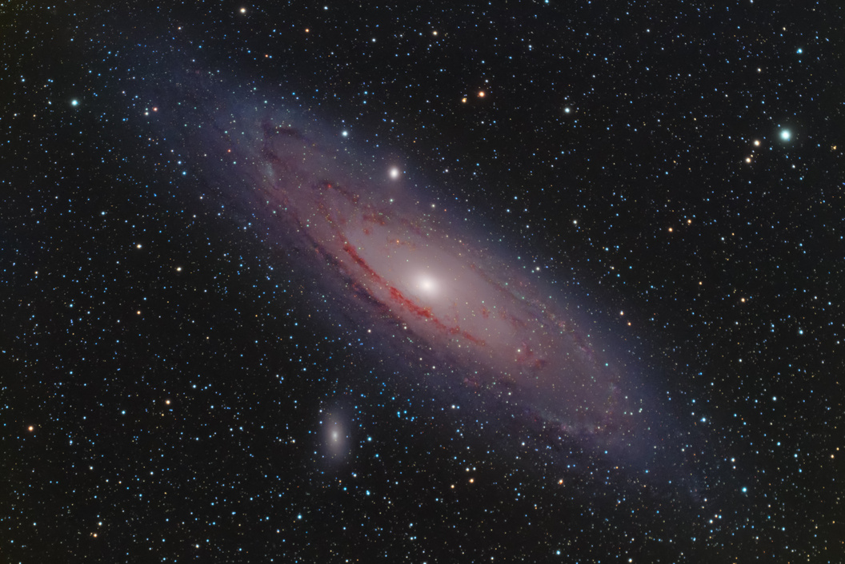

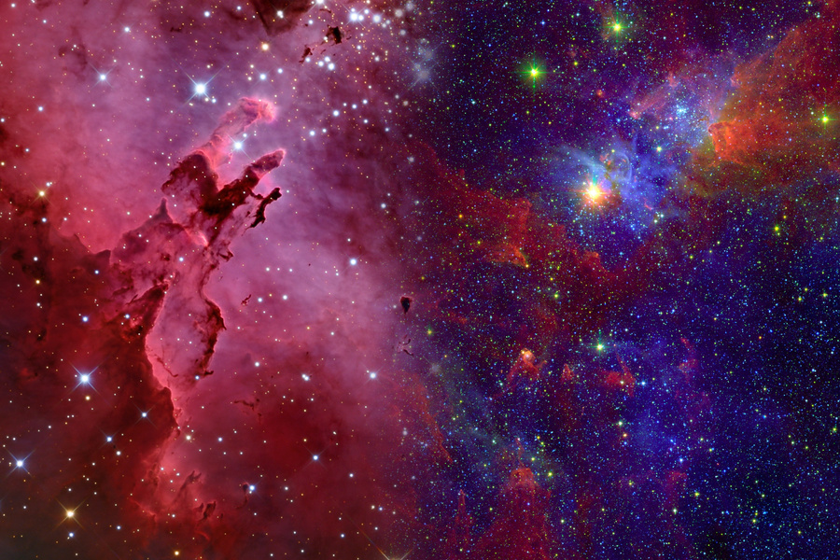


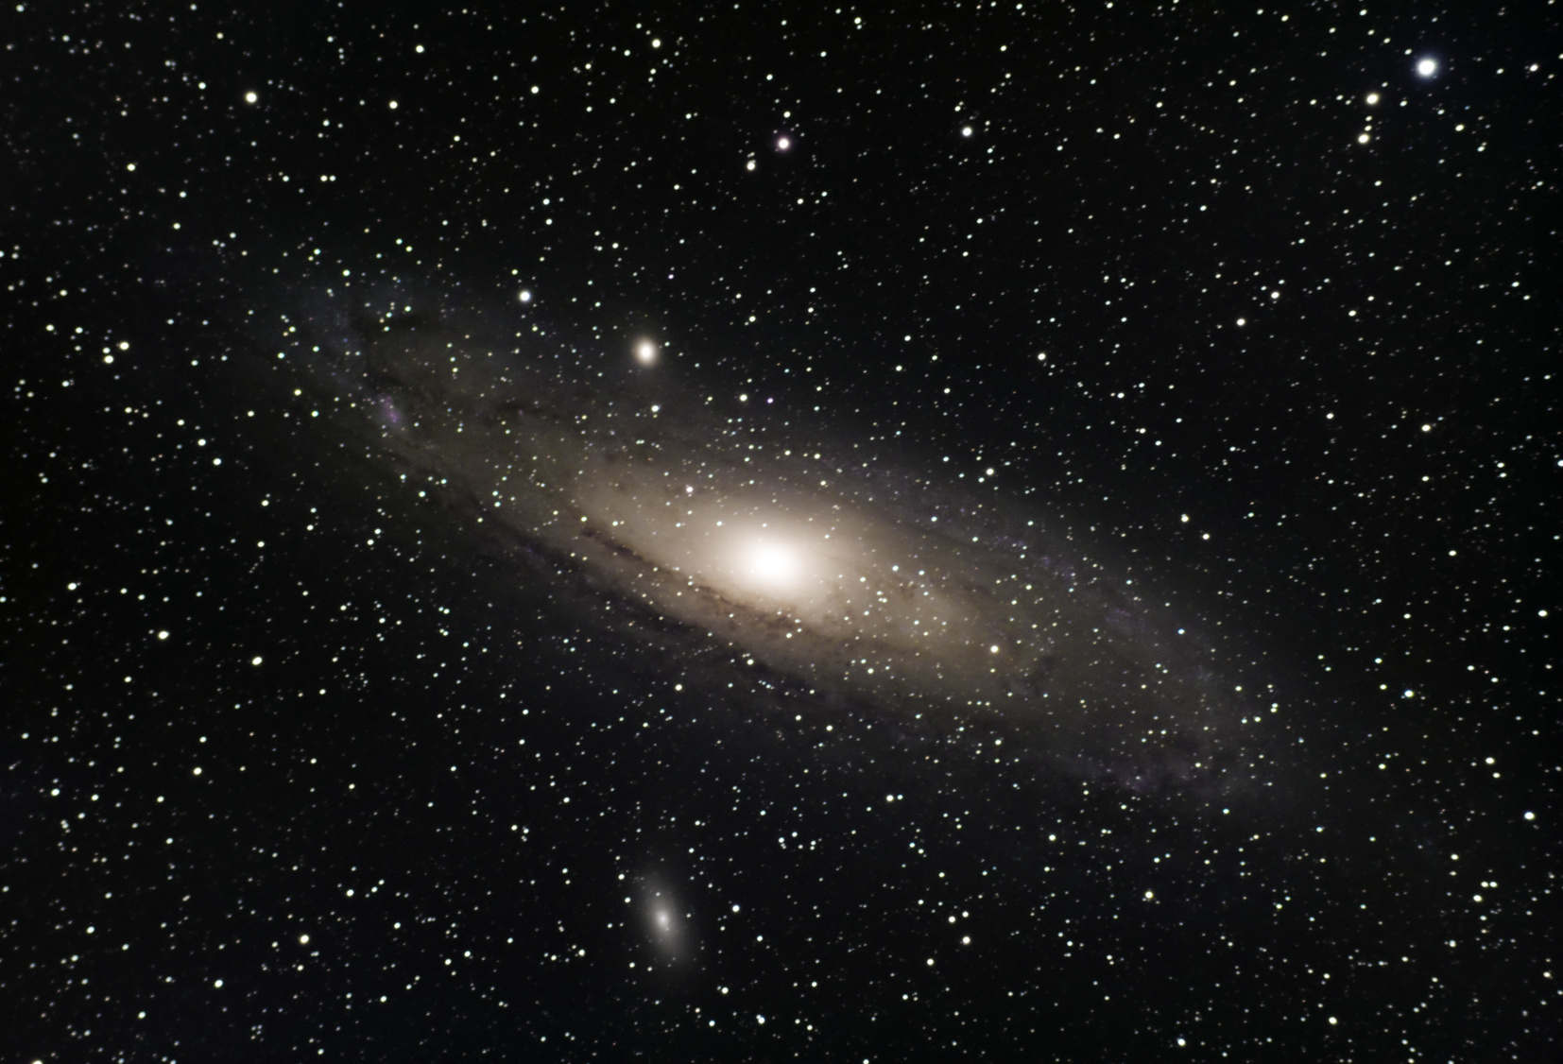
CONCLUSION
Efficient object management is critical in mitigating collision risk and ensuring that objects are following their intended trajectories.
Our dashboard and alerts will aid astronauts with both of these objectives, thereby fostering a safer environment and enhancing space situational awareness.
13

Slide 14
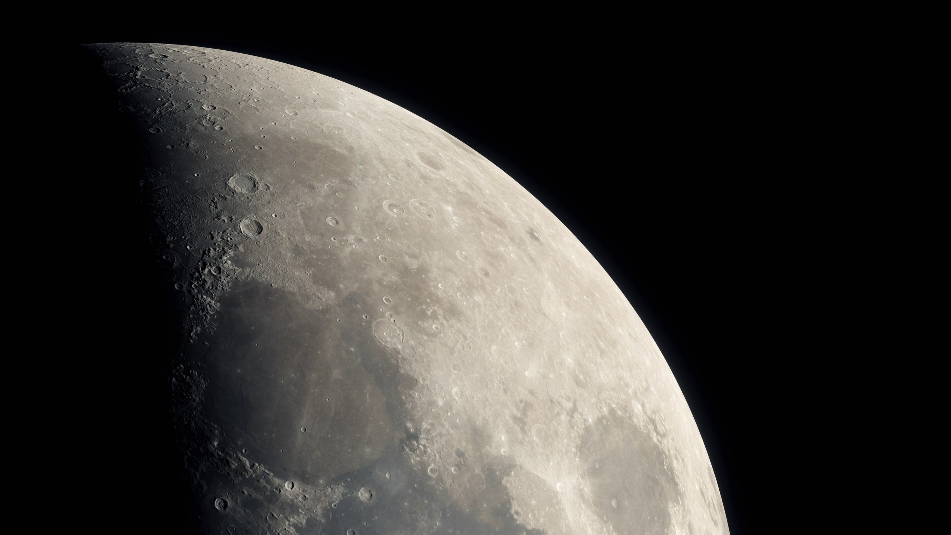

THANK YOU!
14

